Slide 1
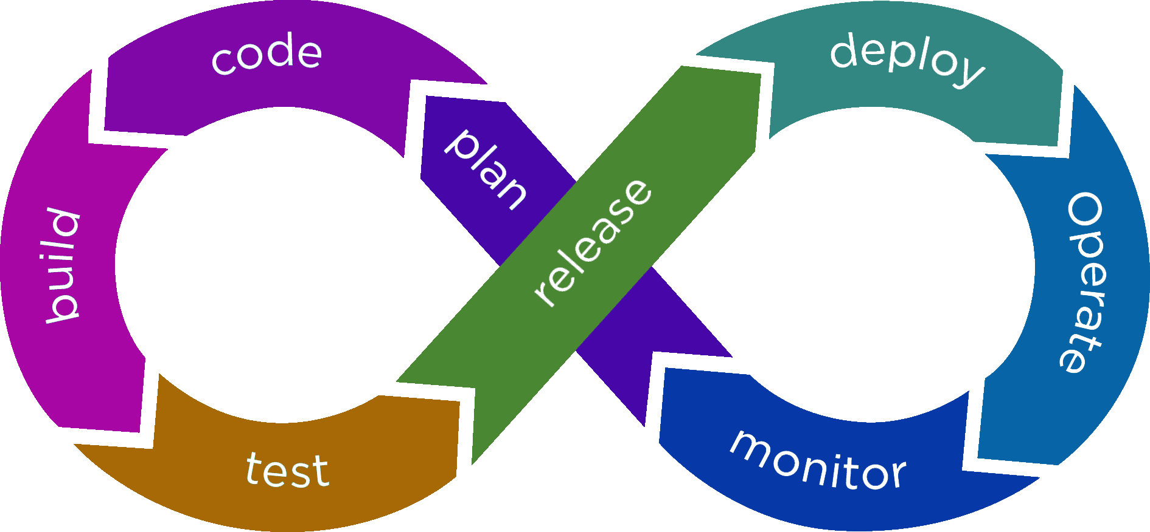
SUBJECT
DevOps Introduction

Slide 2
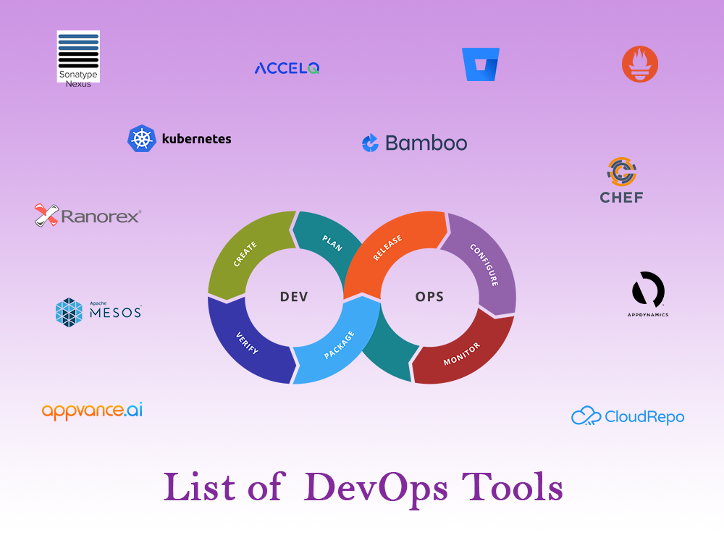
DevOps - Master PPT
Introduction to DevOps

Slide 3

AGENDA
DevOps - Master PPT
DevOps - Start a new journey
Introduction to DevOps
Why did DevOps originate ?
Understanding of primary phases DevOps lifecycle
DevOps Principles
Why DevOps is needed ?
Traditional IT vs DevOps
DevOps Lifecycle
How DevOps Works ?
DevOps Tools
Who is a DevOps Engineer ?
Roles , Responsibilities and Skills of a DevOps Engineer

Slide 4

SOFTWARE DEVELOPMENT
DevOps – Journey Start
Software Development Life Cycle (SDLC) is a process used by the software industry to design, develop and test high quality software’s. The SDLC aims to produce a high-quality software that meets or exceeds customer expectations, reaches completion within times and cost estimates.
SDLC is the acronym of Software Development Life Cycle.
It is also called as Software Development Process.
SDLC is a framework defining tasks performed at each step in the software development process.
ISO- 12207 is an international standard for software life-cycle processes. It aims to be the standard that defines all the tasks required for developing and maintaining software.

Slide 5

SOFTWARE DEVELOPMENT LIFE CYCLE
DevOps – Journey Start
PLANNING
DEPLOYMENT
DEFINING
TESTING
DESIGNING
BUILDING

Slide 6
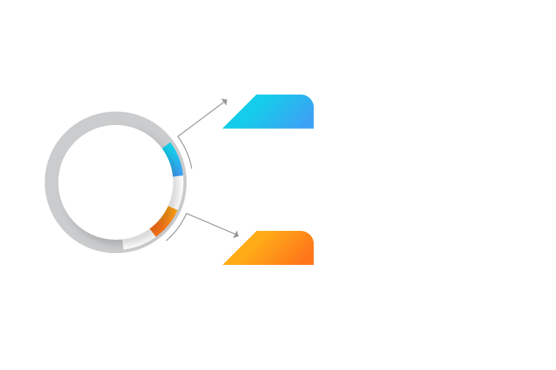
SOFTWARE DEVELOPMENT LIFE CYCLE MODELS
DevOps – Journey Start
WATERFALL
MODEL
S D L C
MODELS
AGILE
MODEL

Slide 7
WATERFALL MODEL
DevOps – Journey Start
REQUIREMENTS
Waterfall approach was first SDLC Model to
be used widely in S/W engineering to ensure
success of the project. In “The Waterfall “ approach , the whole
process of software development is divided
into separated phases mentioned below
DESIGN
DEVELOPMENT
TESTING
DEPLOYMENT
MAINTENANCE

Slide 8
DevOps – Journey Start
In this Waterfall model , typically , the outcome of one phase act as the
input for the next phase sequentially.

Slide 9
WATERFALL MODEL : DISADVANTAGES
DevOps – Journey Start
The disadvantage of Waterfall development is that it does not allow much reflection or revision. Once an application is in the testing stage, it is very difficult to go back and change something that was not well documented or thought upon in the concept stage.
The Major disadvantages of the Waterfall model are as follows :
No working Software is produced until late during the life cycle.
High amount of risk and uncertainty.
Not a good model for Complex and Object Oriented Projects.
Poor model for long and ongoing projects.
Not suitable for the projects where requirements are at a moderate to high risk of changing. So, risk and uncertainty is high with this process model.
It is difficult to measure progress within stages.
Cannot accommodate changing requirements.
Adjusting scope during the life cycle can end a project.
Integration is done as a “Big bang” at the very end, which doesn’t allow identifying any technological or business bottleneck or challenges early.

Slide 10
AGILE MODEL
DevOps – Journey Start
Priority Request
To overcome the challenges faced in the Waterfall model, we came up with the Agile Methodology.
Agile Method believes in creating shorter development life cycles.
Shorter development life cycles are achieved by not releasing all the features at once by following an incremental model of development.
Release & Deployment
DESIGN
Test & Debugging
Coding

Slide 11

AGILE MODEL : ADVANTAGES
DevOps – Journey Start
Customer Satisfaction.
Less Planning required.
Requirements can be.
Functionality can be created and tested quickly.

Slide 12

AGILE MODEL : DISADVANTAGES
DevOps – Journey Start
Not suitable for handling complex dependencies in projects.
Knowledge transfer to colleagues can be difficult since there is little documentation.
Success of the project depends heavily on customer interaction.

Slide 13
Introduction to DevOps
Why DevOps ?
What is DevOps ?
Understanding of DevOps lifecycle.
DevOps Principles.
Why DevOps is needed ?
Ingredients of DevOps.

Slide 14




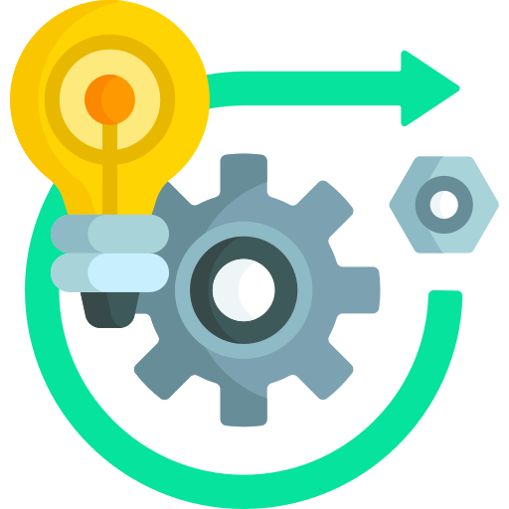
Why DevOps ?
Although the Software quality was improved, we still had a lack of efficiency among the development team. A typical software development team consists of Developers and Operations employees. Let us understand their Job roles.
Software Company
Developers
Operations

Slide 15
Why DevOps ?
A Developer’s job is to develop applications and pass his code to the Operations team.
The Operations team’s job is to test the code, and provide feedback to the developers incase of bugs. If all goes well, the Operations team uploads the code to build servers.
Developers
Operations

Slide 16
Why DevOps ?
The Developer used to run the code on his System, and then forward it to Operations team.
The Operations when tried to Run the code on their System, it did not Run.
Developers
Operations

Slide 17
Why DevOps ?
But, the code Runs fine in the Developer’s System and hence he says, “It is not my fault”.
The Operations then marked this code as faulty and used to forward this feedback to the Developer.
Developers
Operations

Slide 18
Why DevOps ?
Developers
Operations
This led to a lot of back and forth between the Developer and Operations team, hence impacted efficiency.

Slide 19
Why DevOps ?
Developers
Operations
This problem was SOLVED using DevOps.

Slide 20
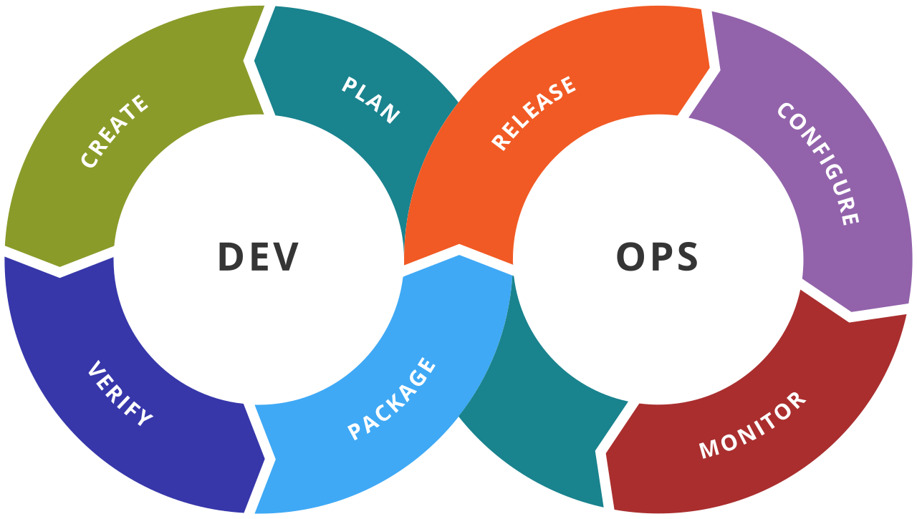
What is DevOps ?
DevOps is a software development methodology which improves the collaboration between Developers and Operations team using various Automation tools. These Automation tools are implemented using various stages which are part of the DevOps lifecycle.
The word 'DevOps' is a combination of two words 'development' and 'operations.’
DevOps helps to increases an organization's speed to deliver applications and services. It allows organizations to serve their customers better and compete more strongly in the market.
Developers
&
Testers
IT
Operations

Slide 21
Understanding of primary phases DevOps lifecycle
Development : In this DevOps stage the development of software takes place constantly. In this phase, the entire development process is separated into small development cycles. This benefits DevOps team to speed up software development and delivery process.
Testing : QA team use tools like Selenium to identify and fix bugs in the new piece of code.
Integration : In this stage, new functionality is integrated with the prevailing code, and testing takes place.
Deployment : In this phase, the deployment process takes place continuously. It is performed in such a manner that any changes made any time in the code, should not affect the functioning of high traffic website.
Monitoring : In this phase, operation team will take care of the inappropriate system behavior or bugs which are found in production.

Slide 22
DevOps PRINCIPLES
Here, are six principles which are essential when adopting DevOps :
Customer–Centric Actions.
End-To-End Responsibility.
Continuous improvement.
Automate everything.
Work as One team.
Monitor and Test everything.

Slide 23
Why DevOps is NEEDED ?
Before DevOps, the development and operation team worked in complete isolation.
Manual code deployment leads to human errors in production
Other Important reasons:
Predictability : DevOps offers significantly lower failure rate of new releases
Reproducibility : Version everything so that earlier version can be restored anytime.
Maintainability : Effortless process of recovery in the event of a new release crashing or disabling the current system.
Time to market : DevOps reduces the time to market up to 50% through streamlined software delivery.
Cost Efficiency : DevOps offers cost efficiency in the software development process which is always an aspiration of IT companies' management.

Slide 24
Traditional IT v/s DevOps
Traditional IT
DevOps
Less Productive.
More Productive.
Skill Centric Team.
Team is divided into specialized Silos.
More Time invested in planning.
Smaller and frequent releases lead to easy
scheduling and less time in planning.
Difficult to achieve Target or Goal.
Frequent releases, with continuous Feedback
Makes achieving Targets easy.

Slide 25
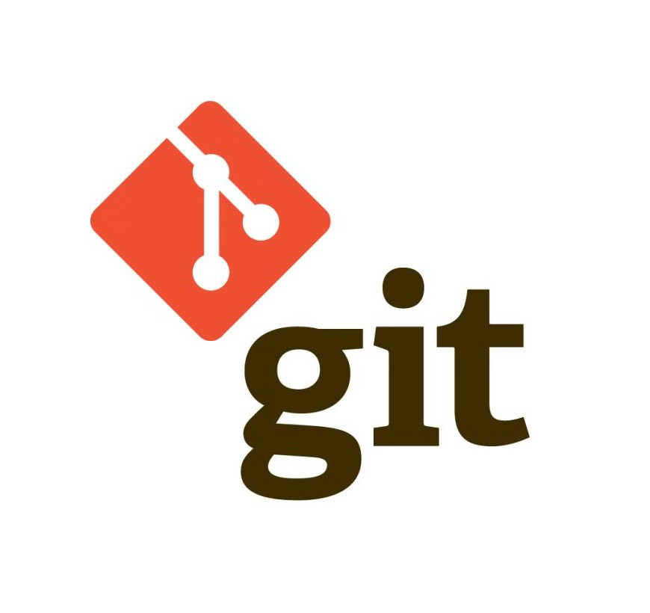
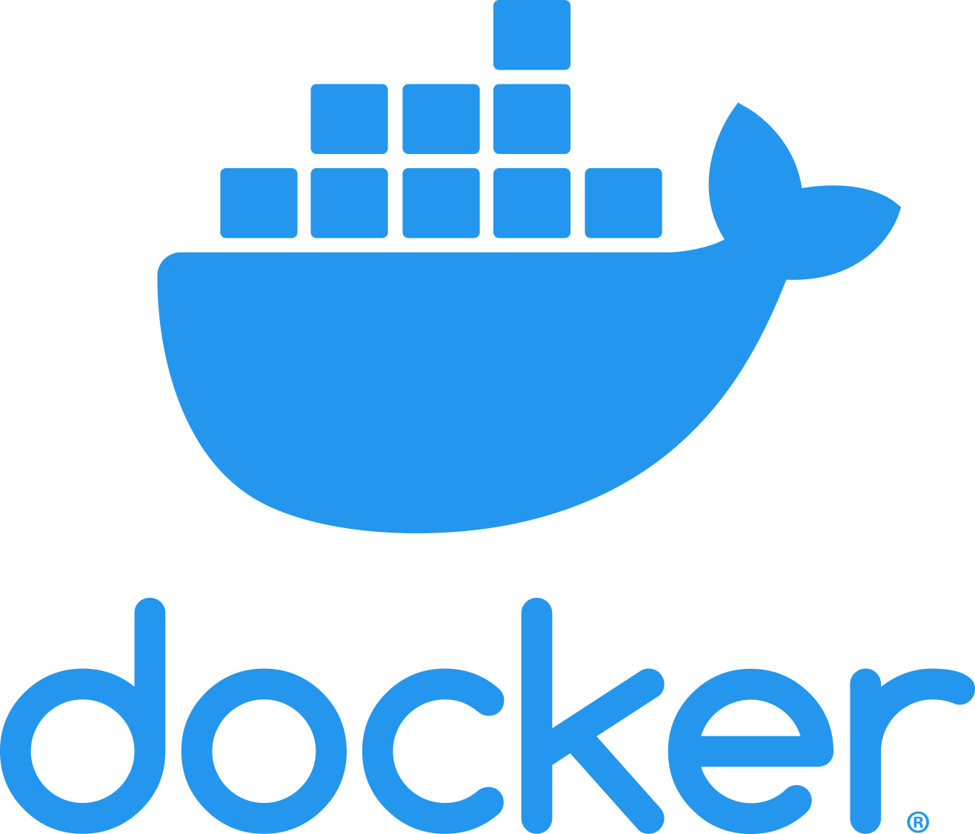



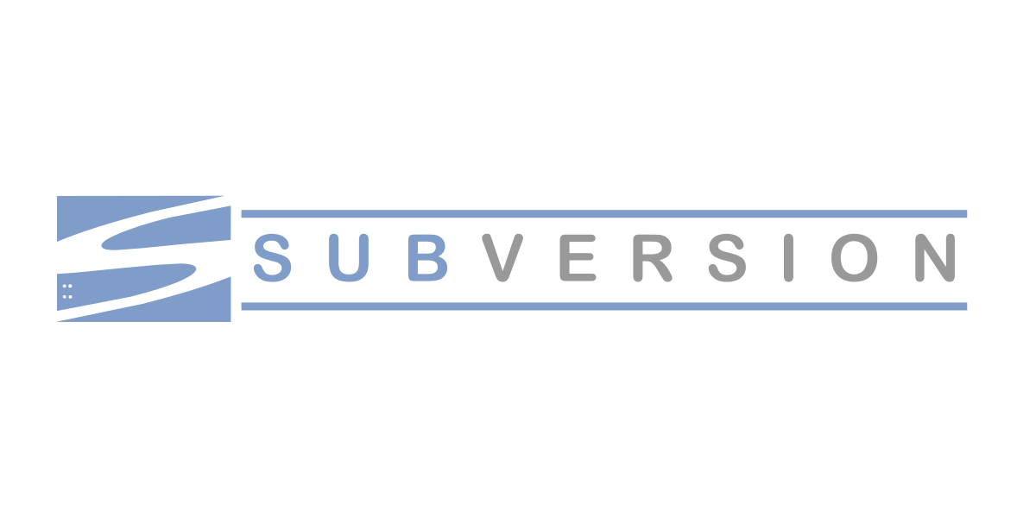
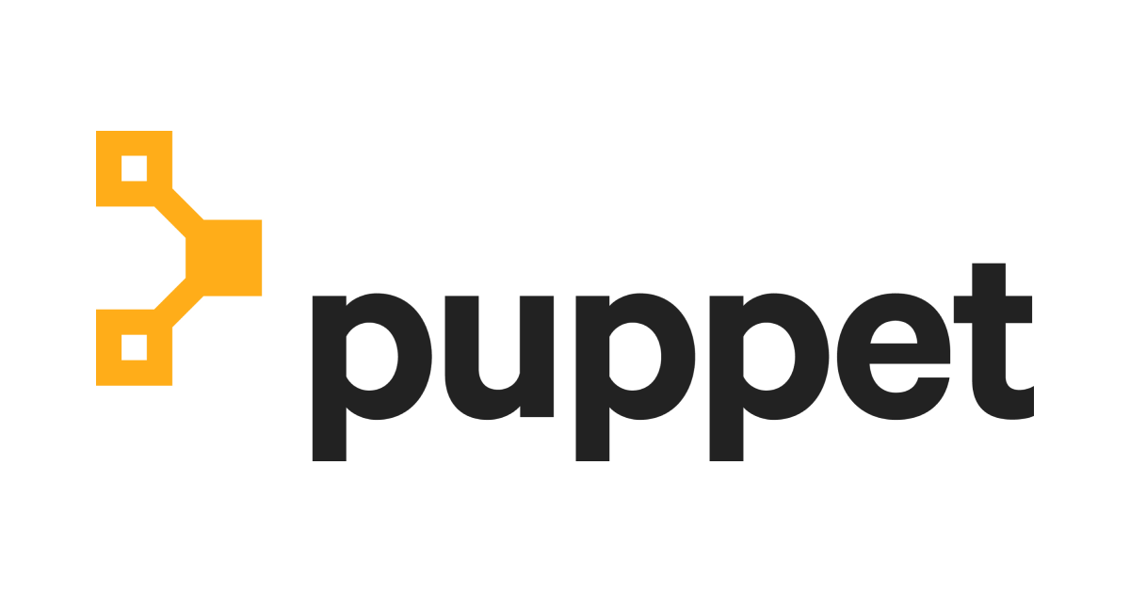
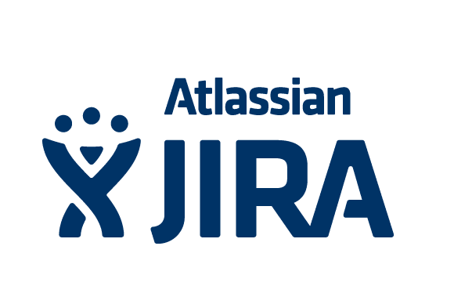


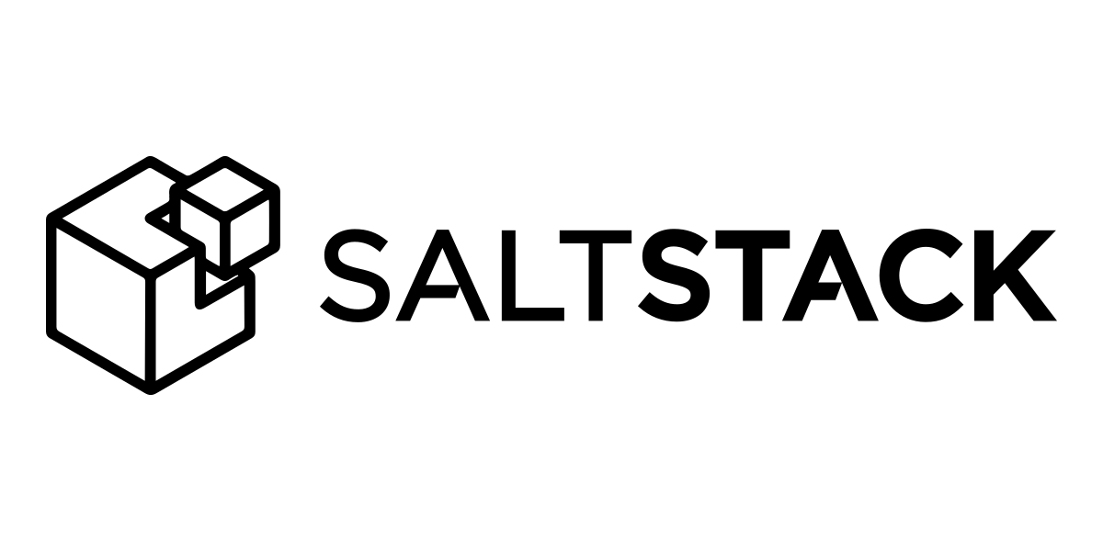
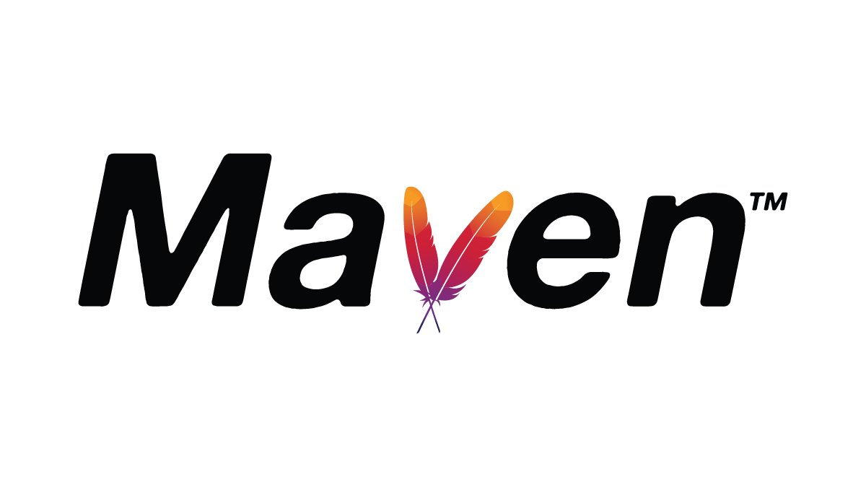
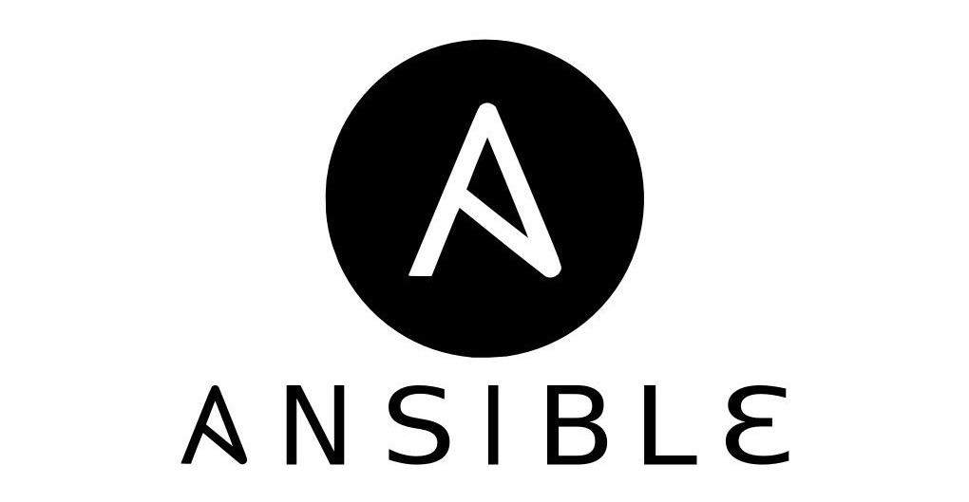
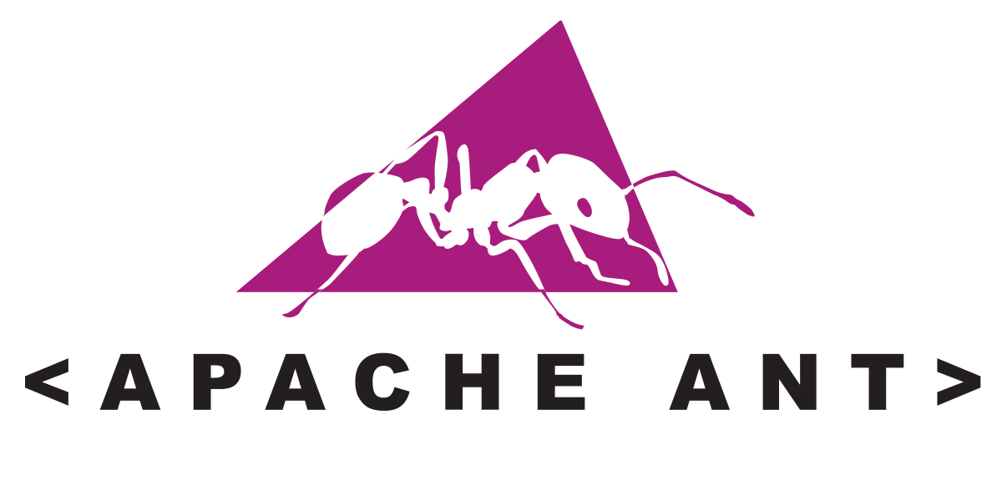






DevOps Lifecycle
PLAN
DEPLOY
CODE
OPERATE
INTEGRATION
BUILD
MONITOR
TEST
Most Used DevOps tools

Slide 26
How DevOps Works ?
The DevOps lifecycle divides the SDLC lifecycle into the following stages
PLAN
PLAN
Continuous
Development
Continuous
Deployment
CODE
CODE
CONTINUOUS
INTEGRATION
BUILD
BUILD
Continuous
Testing
Continuous
Monitoring
TEST
TEST

Slide 27
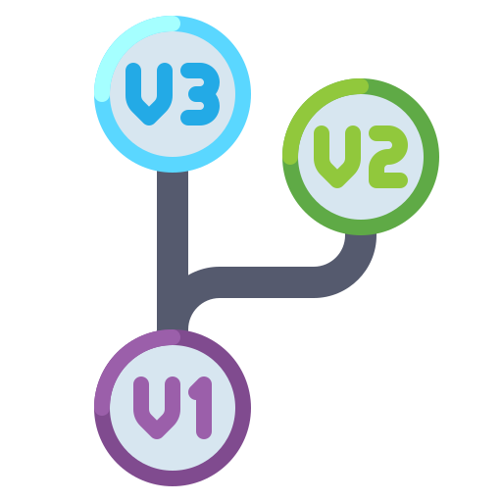
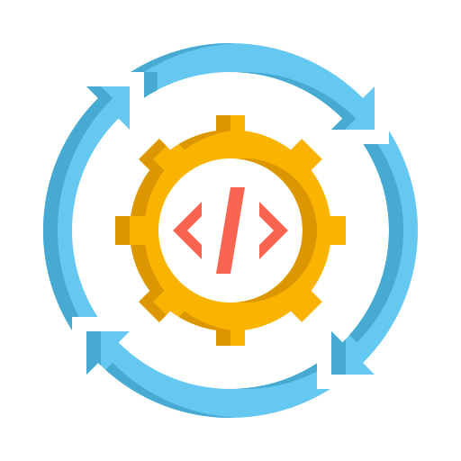
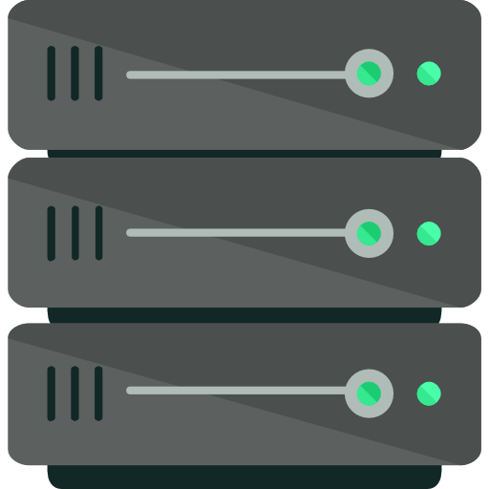
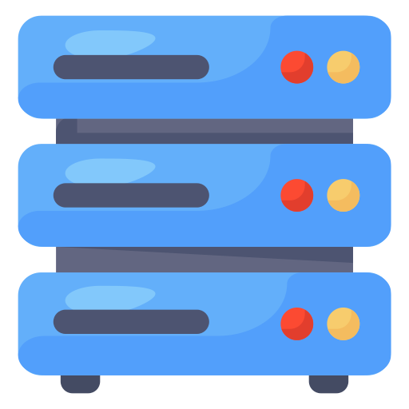
How DevOps Works ?
Continuous
Development
Continuous
Integration
Developer
Version Control
System
Continuous
Deployment
Continuous
Testing
Testing
Server
Pre-Production
Server
Continuous
Monitoring
Feedback

Slide 28
How DevOps Works ?
This stage involves committing code to version control tools such as GIT or SVN for maintaining the different versions of the code and tools like Ant, Maven, Gradle for building or packaging the code into executable file that can be forwarded to the QAs for testing.
Continuous Development
Continuous Integration
Continuous Deployment
Continuous Testing
Continuous Monitoring
Developer

Slide 29
How DevOps Works ?
This stage is a critical point in the whole DevOps lifecycle. It deals with integrating the different stages of the DevOps lifecycle, and is therefore the key in automating the whole DevOps process.
Continuous Development
Continuous Integration
Continuous Deployment
Continuous Testing
Continuous Monitoring

Slide 30
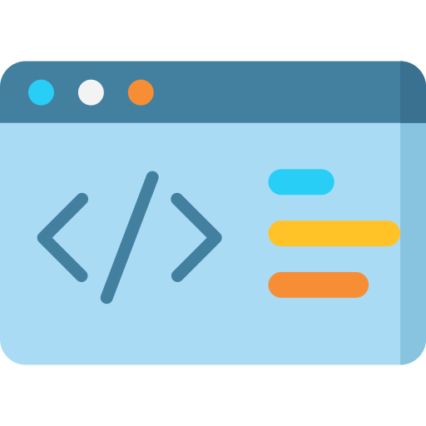

How DevOps Works ?
In this stage the code is built, the environment or the application is containerized and is pushed on to the desired server. The key processes in this stage are Configuration Management, Virtualization and Containerization.
Continuous Development
Continuous Integration
Continuous Deployment
Continuous Testing
Continuous Monitoring

Slide 31

How DevOps Works ?
This stage deals with automated testing of the application pushed by the developer. If there is an error, the message is sent to the integration tool, this tool in turn notifies the developer of the error. If the test was a success, the message is sent to the integration tool which pushes the build on the production server.
Continuous Development
Continuous Integration
Continuous Deployment
Continuous Testing
Continuous Monitoring

Slide 32

How DevOps Works ?
This stage continuously monitors the deployed application for bugs or crashes. It can also be set up to collect user feedback. The collected data is then sent to the developers to improve the application.
Continuous Development
Continuous Integration
Continuous Deployment
Continuous Testing
Continuous Monitoring

Slide 33



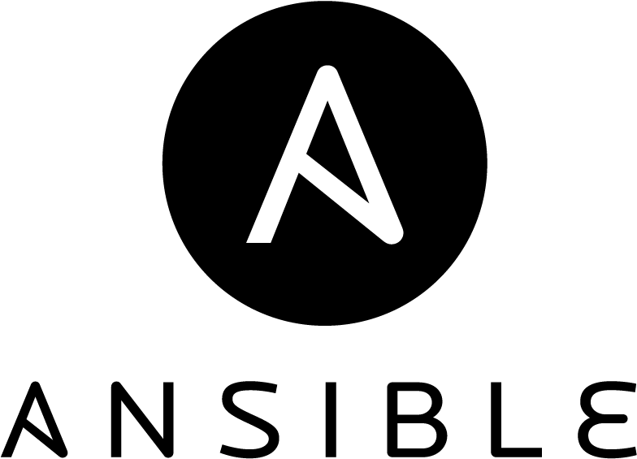


DevOps Tools ?
We have discussed the DevOps Methodology, but this methodology cannot be put into action without its corresponding tools. Let us discuss the DevOps tools with their respective lifecycle stages.

Slide 34
DevOps Tools ?
Git is a Distributed Version-Control System for tracking changes in computer files and coordinating work on those files among multiple people. It is primarily used for source-code management in Software Development, but it can be used to keep track of changes in any set of files.
Continuous Development
Continuous Integration
Continuous Deployment
Continuous Testing
Continuous Monitoring

Slide 35
DevOps Tools ?
Jenkins is an open source automation server written in JAVA. Jenkins helps to automate the non-human part of the software development process, with continuous integration and facilitating technical aspects of continuous delivery.
Continuous Development
Continuous Integration
Continuous Deployment
Continuous Testing
Continuous Monitoring

Slide 36
DevOps Tools ?
Continuous Deployment
Continuous Development
Continuous Integration
Continuous Deployment
Continuous Testing
Continuous Monitoring

Slide 37
DevOps Tools ?
Selenium is a portable Software-testing framework used for Web applications. It is an Open source tool which is used for automating the tests carried out on Web browsers (Web applications are tested using any Web browsers).
Continuous Development
Continuous Integration
Continuous Deployment
Continuous Testing
Continuous Monitoring

Slide 38
DevOps Tools ?
Nagios is an Open source DevOps tool which is used for monitoring systems, network and infrastructure. It also offers monitoring and alerting services for any configurable event.
Continuous Development
Continuous Integration
Continuous Deployment
Continuous Testing
Continuous Monitoring

Slide 39
DevOps Tools ?
Developer
Production
Server
Testing
Server
Feedback

Slide 40
DevOps Tools ?
Infrastructure Automation : AWS
Configuration Management : Ansible, Chef, Puppet
Deployment Automation : Jenkins
Performance Management : App Dynamic
Log Management : Splunk
Monitoring : Nagios
Most Used DevOps tools
PLAN
DEPLOY
CODE
OPERATE
INTEGRATION
BUILD
MONITOR
TEST

Slide 41
Who is DevOps Engineer ?
A DevOps Engineer is an IT professional who works with software developers, system operators, and other production IT staff to administer code releases.
DevOps Engineer should have hard as well as soft skills to communicate and collaborate with development, testing, and operations teams.
A DevOps engineer will work with development team staff to tackle the coding and scripting needed to connect elements of code, like libraries or software development kits.

Slide 42

Q & A Session

